Slide 1
HB 2017 Transit Advisory Committee
March 23, 2018

Slide 2
Meeting Agenda
Welcome and Introductions 5 min.
Public Comment 15 min.
Committee Expansion Proposal 5 min.
High Poverty Definition Discussion 30 min.
Operations & Capital Constraints 30 min.
Updates: 5 min.
Public Workshops
Regional Coordination Selection Process

Slide 3
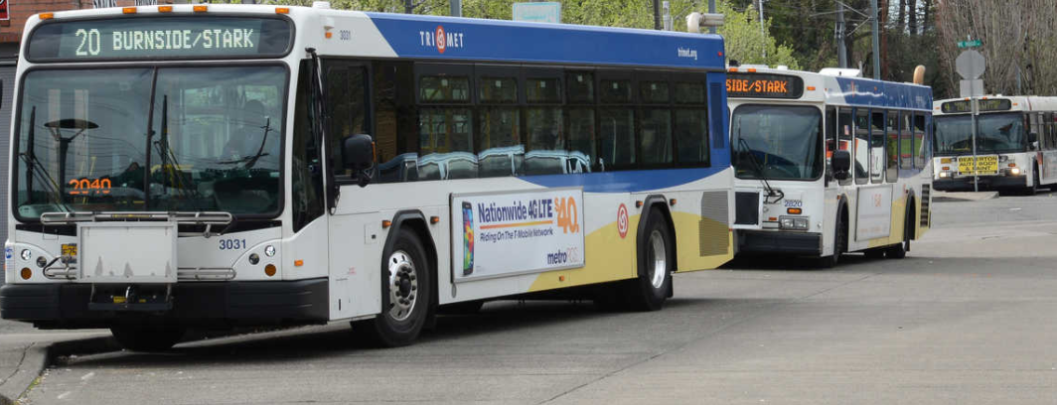
Public Comment

Slide 4
Committee Expansion Proposal
✓
HB2017 rules require we add an “out of district” person to our committee.
Provides an opportunity to expand the committee by 3 people:
  Out of district representative: Dwight Brashear, SMART, Wilsonville
  Environmental justice representative: Huy Ong, OPAL
  Public schools representative: Aron Carleson, Hillsboro Schools Foundation

Slide 5
High Percentage Poverty
Poverty definition: 200% of Federal Poverty Level
What is “high percentage”?
Requests from 2/23 meeting
  Look at percentage intervals between 30%-50%
  Look at raw numbers
  Consider factors other than census data

Slide 6
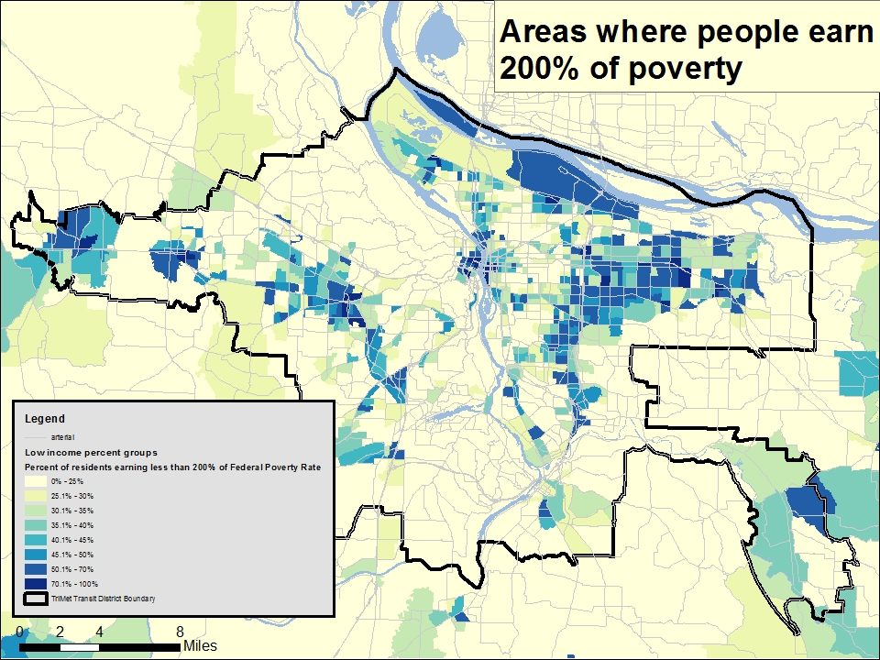

Slide 7
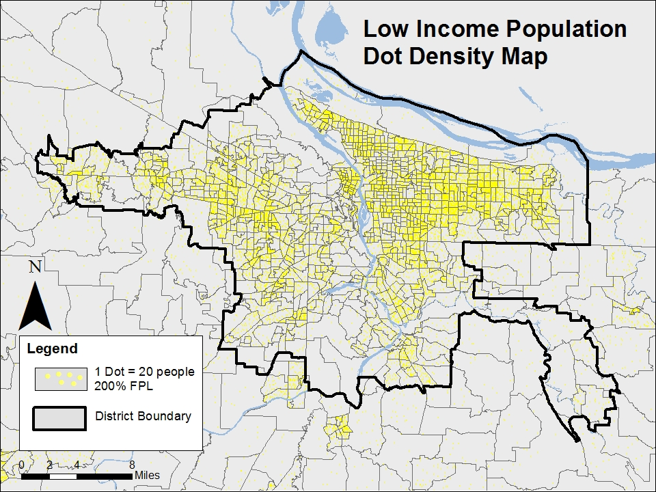

Slide 8
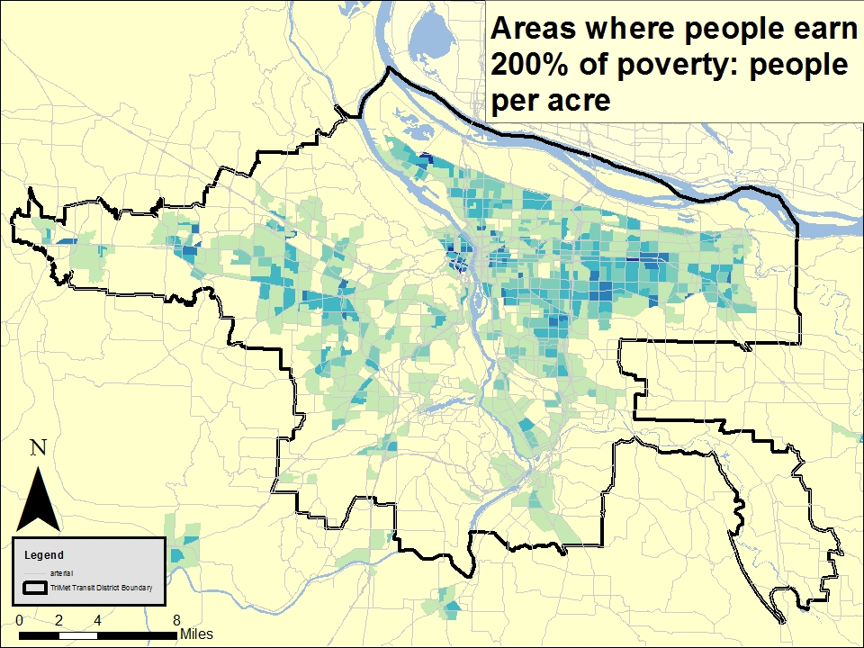

Slide 9
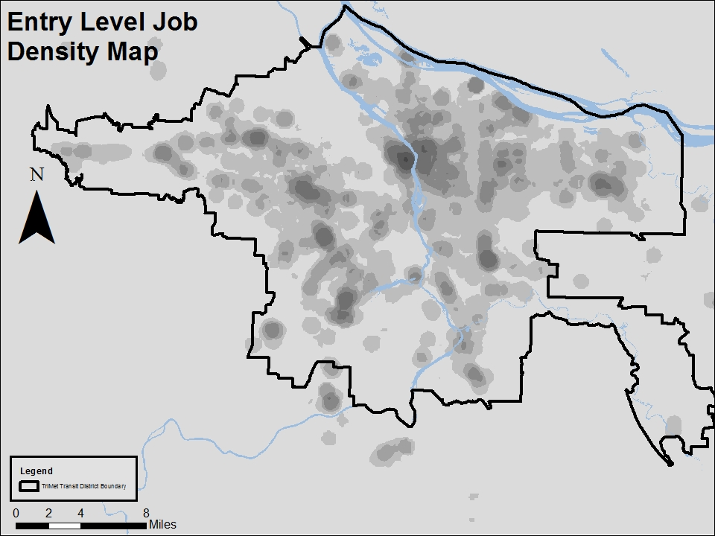

Slide 10
High Percentage Poverty
Consider other factors
  Quantitative: 10 factor analysis
    Minority population Low income population
    Limited English proficiency Senior population
    Youth population People with disabilities
    Limited vehicle access Low & medium wage jobs
    Affordable housing units Key retail/human/social services
  Qualitative: Partner with Coalition of Communities of Color & Metro

Slide 11
High Percentage Poverty
Questions & Discussion

Slide 12
Big Opportunities – Big Questions:
Operations and Capital Constraints
Mix of service vs capital
Mix of service types
Mix of 40’ and 60’ buses
4th operations center
Available staff (mechanics)
Street treatments to move buses through traffic faster
Other?

Slide 13
Constraints
Operations and Capital Constraints
  2 year lead time for bus orders
    Lead time on charging infrastructure for e-buses
  ~ 10-16 month lead time for outreach, planning, and implementation of service
  Human Resources – especially mechanics
  Buses and Facility Capacity

Slide 14
Revenue Concepts
Operations and Capital Constraints
“Base” is the normal growth in the payroll tax.
Base
Notes:
Not to scale

Slide 15
Revenue Concepts
Operations and Capital Constraints
“Base” is the normal growth in the payroll tax.
“Increment” is the phase in of the employer payroll tax at 1/100th of a percent per year.
Increment
Base

Slide 16
Revenue Concepts
Operations and Capital Constraints
“Base” is the normal growth in the payroll tax.
“Increment” is the phase in of the employer payroll tax at 1/100th of a percent per year.
HB 2017 is new state funding.
HB 2017
Increment
Base

Slide 17
Operations and Capital Constraints
Rough illustration of number of mechanics needed to meet service demand
Base

Slide 18
Operations and Capital Constraints
Shortfall before HB2017
Increment
Base
Notes:
Short 25 – 30 mechanics to meet existing growth in buses and bus service
Currently heavy overtime by mechanics
Training
Constrained apprenticeship program
Limited ability to hire

Slide 19
Operations and Capital Constraints
Shortfall with HB2017
To get new mechanics, they must enter apprenticeship class two years earlier
HB 2017
Increment
Base

Slide 20
Operations and Capital Constraints
Buses and Facility Capacity: Base
Need 4th garage
Base

Slide 21
Buses and Facility Capacity: Base and Increment
Operations and Capital Constraints
Need 4th garage
Need interim solution
Increment
Base

Slide 22
Buses and Facility Capacity: Base, Increment and HB 2017
Operations and Capital Constraints
Need interim solution
Need 4th garage
HB 2017
Increment
Base

Slide 23
HB2017 “Ramp Up
Operations and Capital Constraints
Five year ramp up of new service – fastest that supply of mechanics and bus maintenance availability will allow.
Improvements in the early years may be weighted towards non-peak improvements: earlier/later service, midday service, and weekend service.
HB 2017
Increment
Base

Slide 24
5-Year HB2017 Funding Allocation
$55 mil
Low Income Fare
$12 mil (22%)
Remaining HB2017 Funding $36 mil (66%)
FY19 Service
Proposal $4 mil (7%), Approx. 1,600 weekly vehicle hours
Regional
Coordination
$3m (5%)

Slide 25
5-Year HB2017 Funding Allocation
$55 mil
Low Income Fare
$12 mil (22%)
Capital Purchases
$17 mil (31%)
FY19 Service
Proposal $4 mil (7%), Approx. 1,600 weekly vehicle hours
FY20-23 service improvements
$19 mil (35%)
Approx. 4,700 weekly
vehicle hours
Regional
Coordination
$3m (5%)

Slide 26
Operations and Capital Constraints
Summary of needs:
  Interim bus facility
  4th bus base
  New Buses
  Training space
  Hiring (operators, mechanics, etc.)
  Electric vs. standard buses:
    capital delta is ~$300k but coming down. Lifecycle costs lower if battery life achieved, but additional charging infrastructure and facility costs needed.
  Articulated vs. standard buses:
    capital delta is ~$300k per bus, but provide ~50-60% greater passenger capacity, plus additional facility costs.

Slide 27
Operations and Capital Constraints
Questions & Discussion

Slide 28
Public Workshops
Updates
4 Workshops
  East Portland/East Multnomah County
  North/Northeast Portland
  Clackamas County
  Washington County
In April & May
IRCO – designing, promoting and facilitating the workshops

Slide 29
Regional Coordination Selection Process
Updates
$3 mil set aside for regional coordination
  Connecting out of district services
  Last mile services
Developing a process to decide what projects to fund
A committee will make selections and recommendation to the HB2017 Transit Advisory Committee

Slide 30
Next Meeting: April 20th or 27th?
Currently scheduled for the 20th. Can we move to the 27th?
Other investments:
  Electric Bus
  Articulated Bus
  System Capital
  Enhanced Transit
Public Workshops Update
Regional Coordination Selection Process Update

Slide 31
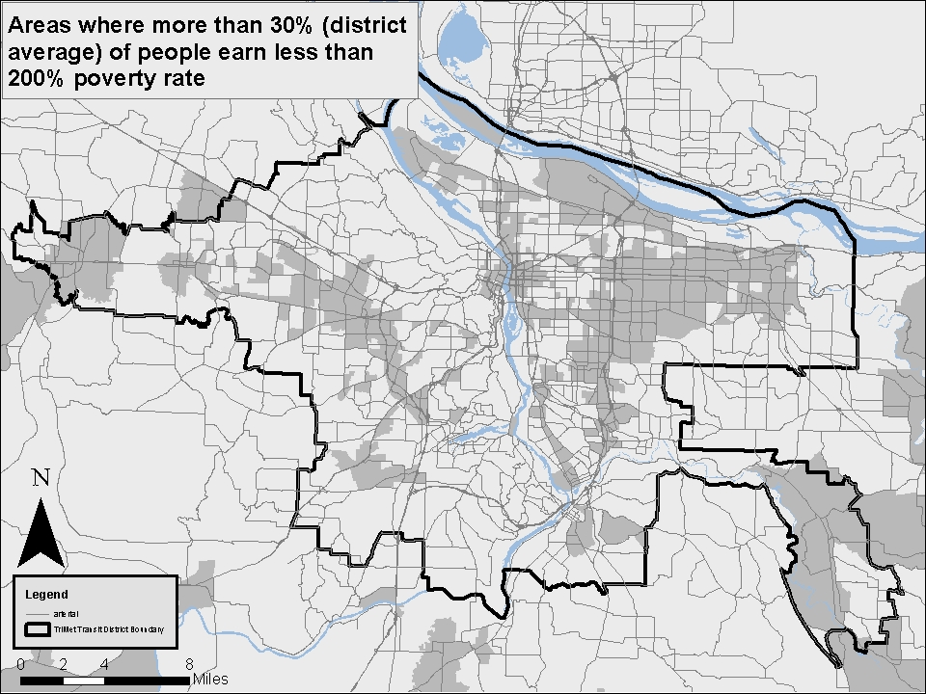

Slide 32
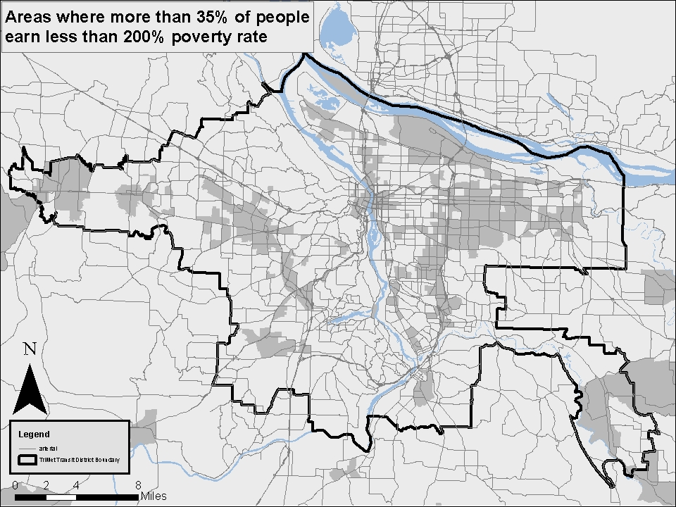

Slide 33
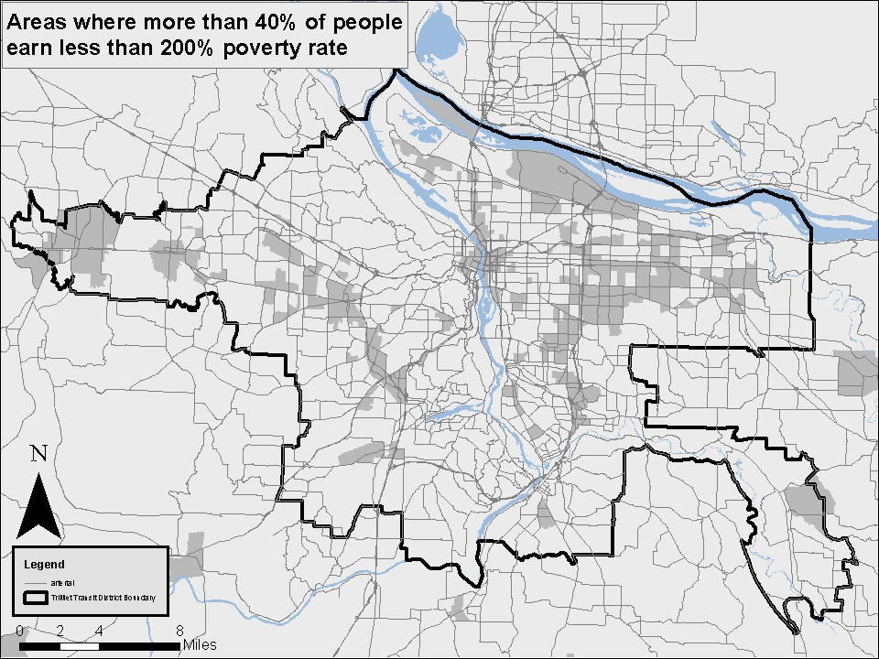

Slide 34
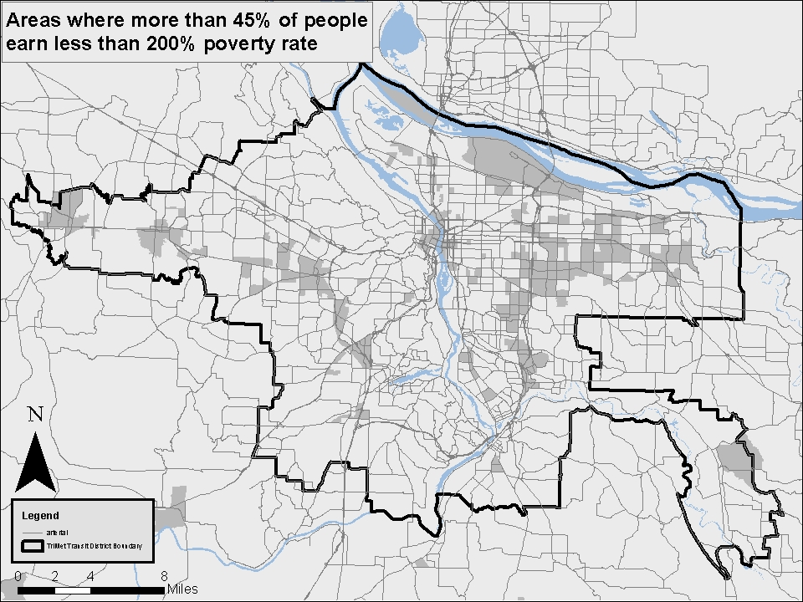

Slide 35
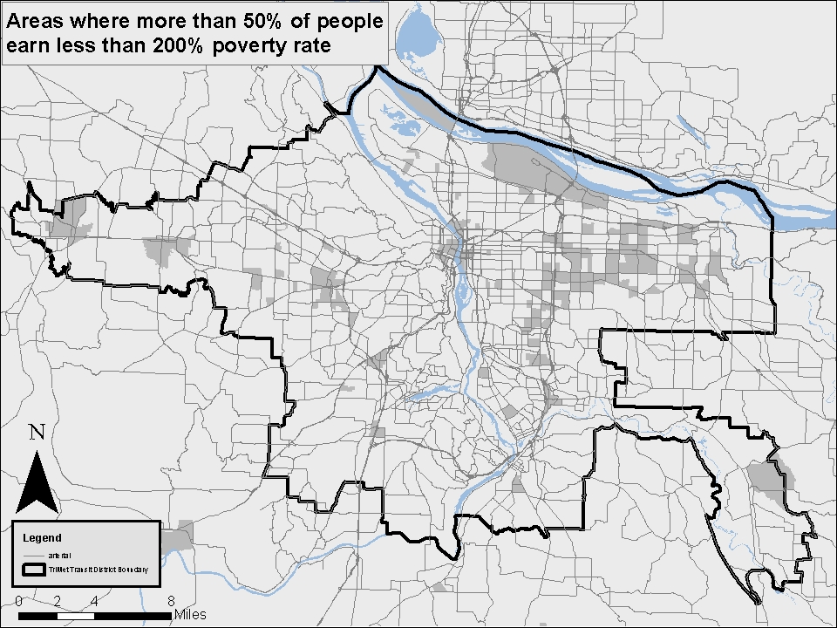

Slide 36
