Slide 1
Public Transportation Improvement Plan Advisory Committee
December 12, 2017

Slide 2
Meeting Agenda
Welcome and Introductions
Review of Last Meeting
Adopt Committee Bylaws
Work Plan and Guiding Statement
Early Decision Points
  Low Income Fare
  Regional Coordination
  FY19 Service Proposal
Public Comment

Slide 3
Follow Up: New Members
Dan Bower, Executive Director, Portland Streetcar
Pat Daniels, Executive Director, Constructing Hope
Esmeralda Flores, Rider Representative: Washington County
Renata Frantum, Rider Representative: East Portland/East Multnomah County
Ben Johnson, Rider Representative: Clackamas County
Diana Nunez, President, Hispanic Metropolitan Chamber

Slide 4
Review of HB 2017
Comprehensive transportation package
1/10th of 1 percent payroll tax on individuals
90% of funds raised returned to district
  Grant-based not formula-based
Tax imposed July 1, 2018
1st funds received ~Jan. 1, 2019
FY 2019 ~$26m, FY 2020 ~$50m
Advisory Committee
  TriMet Plan & Regional Plan
  We’re ahead of the rules committee

Slide 5
Advisory Committee Bylaws
✓
Name & Committee Purpose
Committee Operation
Subcommittees
Officers
Committee Membership
Member Responsibilities
Member Appointment and Alternates
Adoption and Amendment

Slide 6
Advisory Committee Decision Making
 | In favor
 | Against
 | Move forward with the option to revisit depending on other results

Slide 7
Advisory Committee Guiding Statement
✓
The Public Transportation Improvement Plan will guide TriMet on how to spend State Transportation Improvement Funds (STIF) for the following purposes:
expansion of existing/creation of new transit services, except for light rail, with consideration for communities with a high percentage of low-income households,
programs to reduce transit fares for communities with a high percentage of low-income households,
procurement of buses powered by natural gas or electricity,
capital projects required for the creation, expansion or improvement of transit services,
expansion of existing/creation of new transit services in communities outside the TriMet service district, but inside in Clackamas, Multnomah, and Washington counties, and
regional coordination/reduction of fragmentation between TriMet and communities outside the TriMet service district, but inside Clackamas, Multnomah, and Washington counties.

Slide 8

Advisory Committee Work Plan
PTIP Advisory Committee Guiding Statement
✓
Dec.
2017
✓
✓
✓
Regional Coordination
(e.g., shuttles)
New Service: FY19
Low Income Fare
✓
New Service: FY20-23
Jan.
2018
Service vs. Capital: service vs buses vs. system capital?
✓
Feb.
2018
✓
Service Tradeoffs
Mar.
2018
✓
Service Plan
✓
April
2018
= Decision Point
Final Public Transportation Improvement Plan

Slide 9
Early Business: Low Income Fare
✓
HB 2017: programs to reduce fares for public transportation for communities with a high percentage of low-income households

Slide 10
Poverty has been increasing…

Slide 11
Changes in poverty by race since 1990 in the Portland Metro region

Slide 12
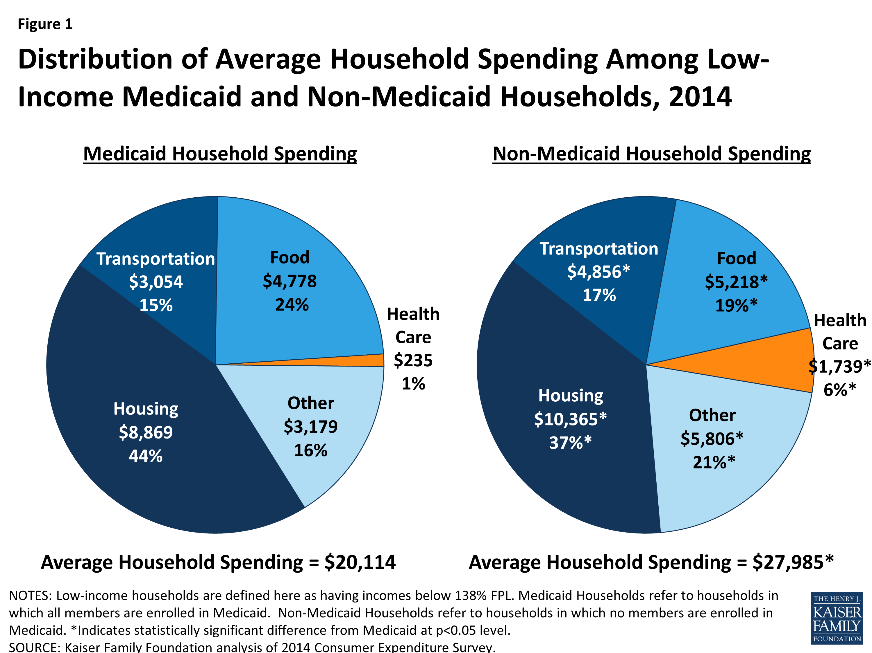

Slide 13
      TriMet spent 3 years investigating the feasibility of a broader low-income fare program
Sustainable: Funding is ongoing and costs are shared with regional partners.
Meaningful: Program is designed to address needs of low-income riders. Access should be convenient and easy for customers.
Targeted: Benefits should be directed to those that need them most, by way of established eligibility criteria. Program employs eFare technology to maximize direct impact.
Manageable: Administering the program requires minimal cost and leverages existing agency agreements with nonprofits and community based organizations. Eligibility should be managed by organization(s) that have expertise in screening for income-based programs.

Slide 14

Research Areas
  Goals and objectives of low income programs across the country
  Discounts offered
  Program funding strategies and sources
  Subsidy levels and any available revenue and cost impacts as well as ridership data
  Eligibility requirements and income thresholds
  Verification and means testing processes
  Fare payment technology / eFare applicability
  Reporting requirements
  Other relevant findings, including information on business processes, administrative practices, and lessons learned

Slide 15


Low Income Fare Taskforce
TriMet Leadership and Metro Councilor Sam Chase
22 members from across the Tri-County area
A regional collaborative effort

Slide 16
Taskforce Participants
Multnomah County | Chair Deborah Kafoury Christian Gaston | Portland Commissioner Amanda Fritz Tim Crail | Wood Village Mayor Tim Clark
Washington County | Commissioner Dick Schouten | Beaverton Mayor Denny Doyle | Forest Grove Mayor Pete Truax
Clackamas County | Clackamas County Commissioner Jim Bernard | Milwaukie Mayor Mark Gamba | Commissioner Renate Mengleberg Theresa Christopherson
Legislative | Rep Lew Frederick | Rep. Diego Hernandez | Rep. Alissa Keny-Guyer
Community Based Organizations | OPAL – Huy Ong Oregon Food Bank,TEAC, Anneliese Koehler | Coalition of Communities of Color, Maggie Tallmadge Street Trust (BTA) Rob Sandusky | Ride Connection, Elaine Wells BRU, Orlando Lopez APANO, Duncan Hwang
Other Participants | MT Hood Community College, Michael Calcagno | David Douglas School District, Frieda Christopher | Washington County Economic Alliance, Pam Treece

Slide 17
Taskforce Meetings
Meeting 1 - Build understanding of existing programs around the country
Meeting 2 - ORCA Lift Case Study review
Meeting 3 - Program Parameters, subsidy and eligibility, balancing the tradeoffs
Meeting 4 - Funding Ideas, Options, and Strategies
Meeting 5 - Final Recommendations and Next Steps

Slide 18
Taskforce Final Outcomes
Taskforce members agreed to support the development of a regional LIF program
Recommended eligibility of up to 200% FPL
Recommended a program subsidy at 50% off of an Adult day pass and 70% off of an Adult monthly pass
  Equivalent to Honored Citizen and Youth Fare structures

Slide 19
Projected Cost and Funding Strategy
Approximately $12.3 million; supporting up to 45,000 riders
Advocate for public transportation funds => State’s Transportation package… Transportation Package Passed!!!
TriMet’s commitment that new resources would be prioritized to fund the new LIF Program and service increases
Funding = statewide payroll tax (1/10 of 1%) set for 7/18
Funds will not be received until early 2019; however, TriMet’s goal is to operationalize in July 2018

Slide 20
Program Development - Outreach
Transit Equity Advisory Committee (TEAC)
Low Income Fare Taskforce
TriMet Community Partner Forums
TriMet Fall 2017 Open Houses
Online Survey

Slide 21
Program Development – Next Steps
Board Ordinance
Database development
Online application portal
Marketing and Communication Plan
Partnership MOU’s
Procurement of Registration sites
Field Training
System Testing
July program launch

Slide 22
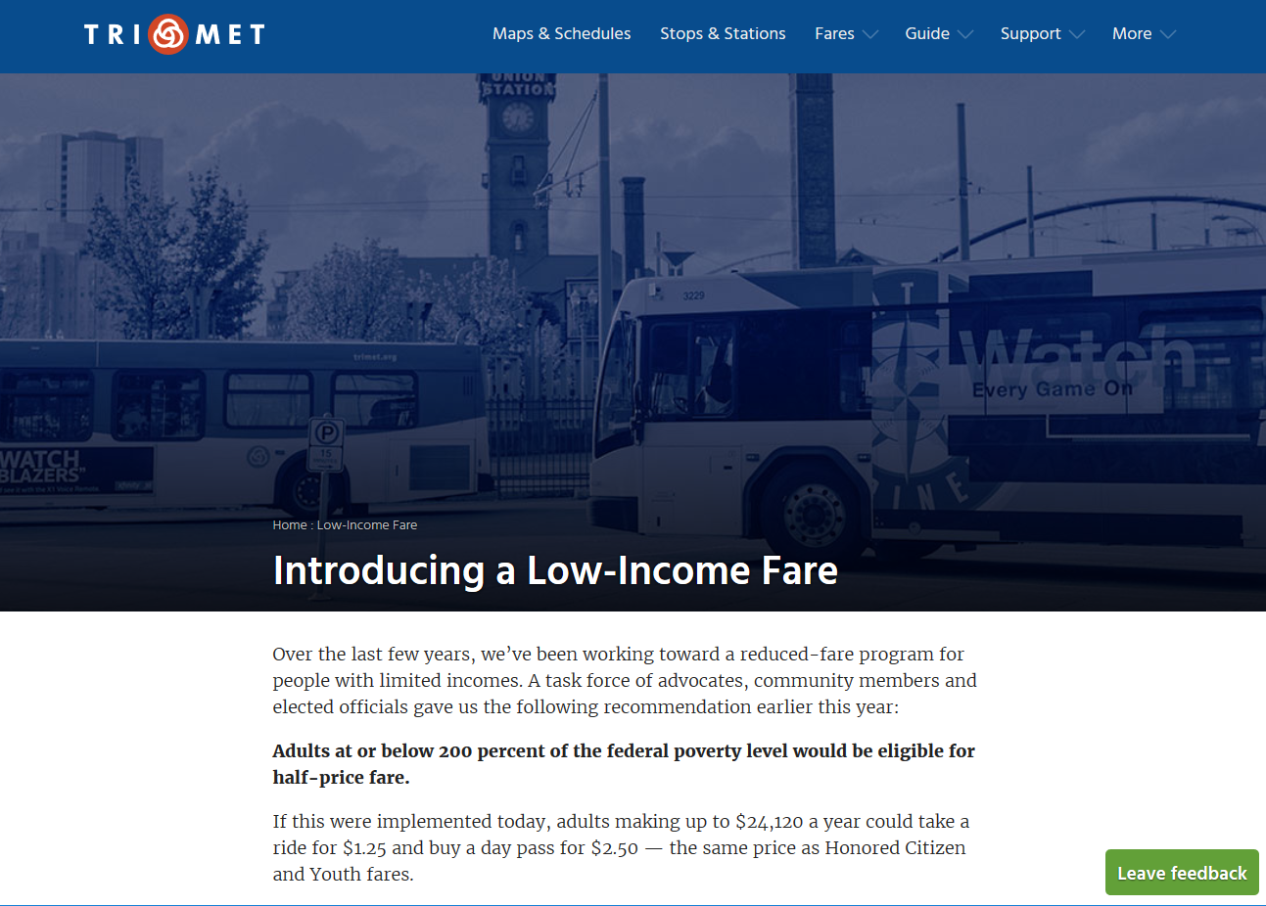

Slide 23
Questions?
Lead Program Contact
TriMet’s Diversity and Transit Equity Director
John Gardner
Questions or Ideas –
https://trimet.org/lowincome/index.htm
gardnerj@trimet.org

Slide 24
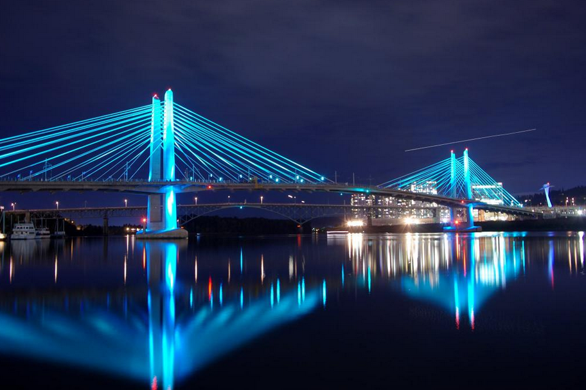
Public Comment

